Slide 1
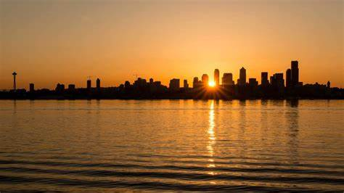
Identifying Neighborhoods of Value in a Crowded Seattle Market
A Cluster Analysis and Machine Learning Exploration

Slide 2
Business Objective
Our purpose is to find the neighborhood(s) and or retail establishments that have the most potential for future value growth.

Slide 3
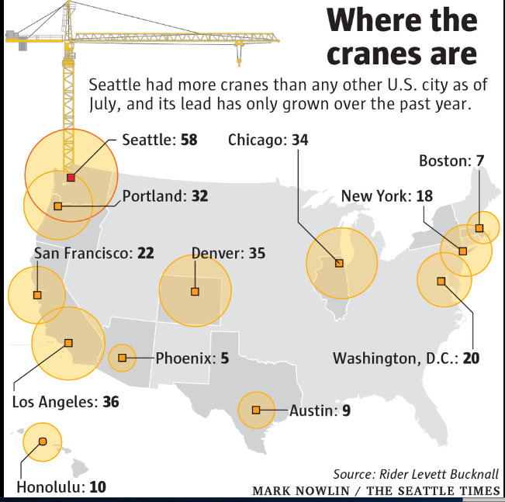
2020 Census Will Show Seattle has Changed
Seattle has experienced tremendous growth since the 2010 Census
We must maximize value opportunities by identifying underdeveloped areas
We need preserve capital and manage risk by avoiding overdeveloped “trendy” neighborhoods

Slide 4















Seattle has been overpriced by high paying, entry level tech jobs
Young “locals” are living at home longer as property has become unaffordable
Wealthy “Eastsiders” are choosing to live in Seattle and commute to Bellevue/Redmond
Neighborhoods with Single family homes will have a higher average Value
Retail establishments in neighborhoods with extremely high Value will suffer from poor foot traffic

Slide 5
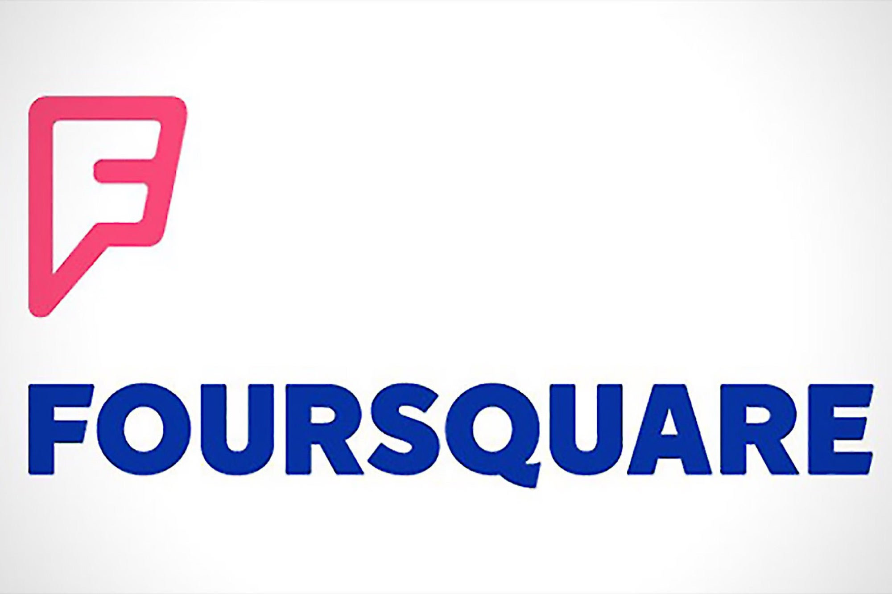
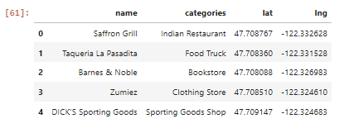
Data Collection
Location Data (via API)
To query, map, and correlate venue types, density, location, etc.

Slide 6
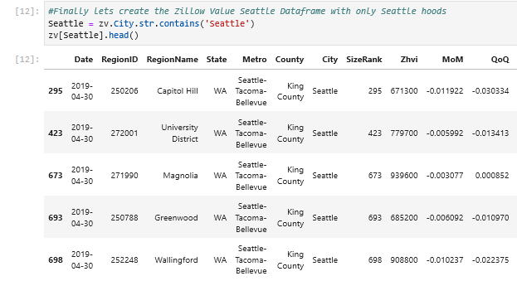
Data Collection
Real Estate data (CSV via website, April 2019)
To examine Home Value and 5 Year Growth rate among Seattle neighborhoods

Slide 7
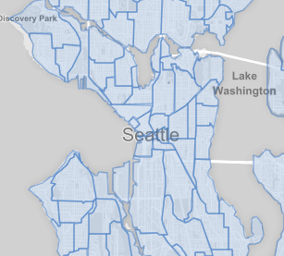
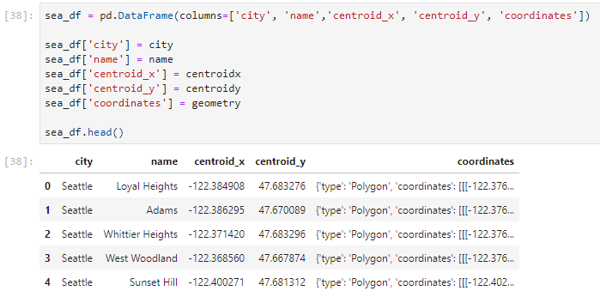
Data Collection
Neighborhood Boundaries
(GeoJson via SeattleIO Github)
To extract coordinates from the nested Polygon Geometry

Slide 8
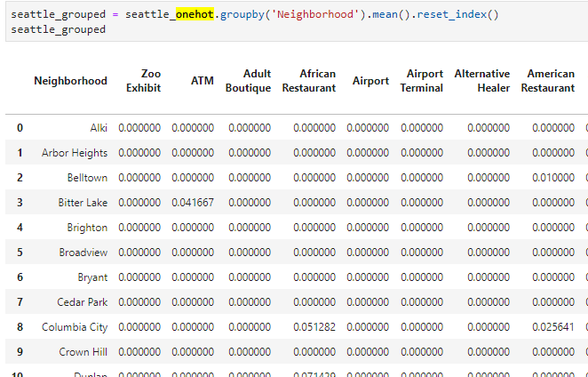
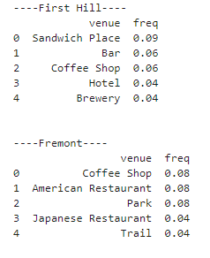
Foursquare data processing
All Venues were called from the Foursquare API and weighted by frequency using the “One Hot Encoding” method

Slide 9
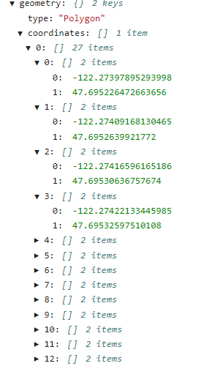
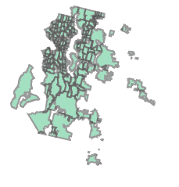
Zillow data processing
Neighborhood dataset was filtered by city to remove all places outside of Seattle
Spreadsheet was merged with the SeattleIO GeoJson in order to map neighborhoods with latitude and longitude coordinates
Nested “Polygon” Geometry was difficult to extract into a dataframe
X,Y Centroids were ultimately put into a dataframe and used as “Point” Geometry due to Folium not rendering the complex Shapes in Jupyter Notebook

Slide 10
Assumptions of deriving Home value by neighborhood?
Averaging Home Sales by Neighborhood would be tedious and inaccurate
City tax assessments are almost always a poor reflection of actual value
Old homes and vacant lots have been cleared out to construct more valuable structures
Foreign investors have been speculating on property for years bidding prices up
Buyers have faced stiff competition and have been paying above listing price

Slide 11
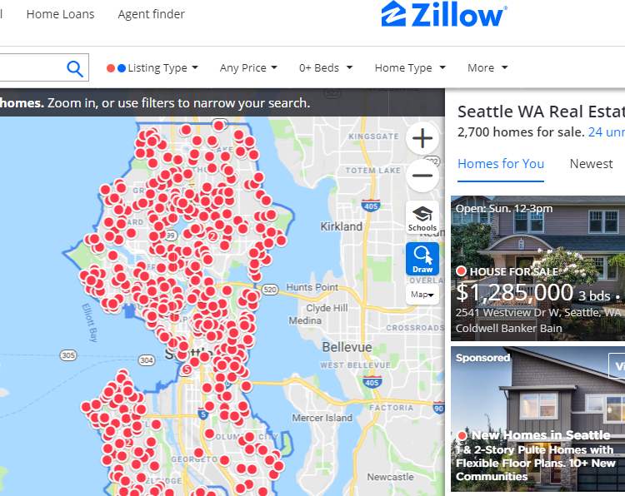
Introducing Zillow Value
Zillow was founded in 2006 by former Microsoft execs
Has become the premier site for Home and Rental listings in the United States
Developed proprietary algorithm for valuing homes called Zillow Value or Zestimate

Slide 12
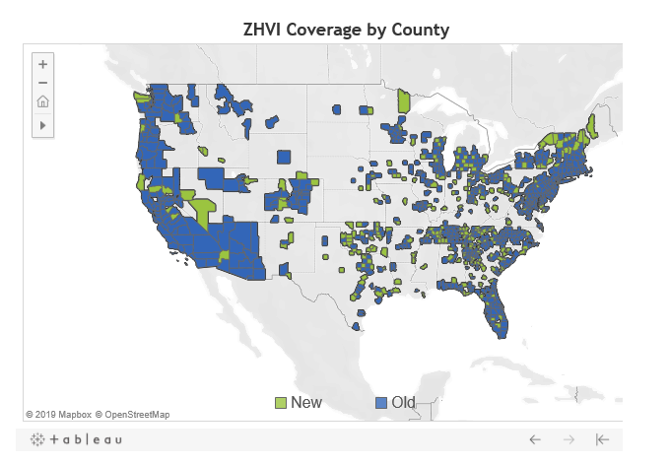
What is Zillow Value (ZHVI)?
A complex machine learning model that uses techniques such as:
Market Clustering (segmentation)
Historical Sales
Seasonality
Moving Average Filters
Strengths | Weaknesses
Urban Markets | Rural Markets
Improves over time with more data | Bad rep from when Zillow was new and data was sparse
Headquarters in Seattle assumes careful accuracy | Neighborhoods bordering retail and abandoned structures
State of the Art Data Science Team

Slide 13
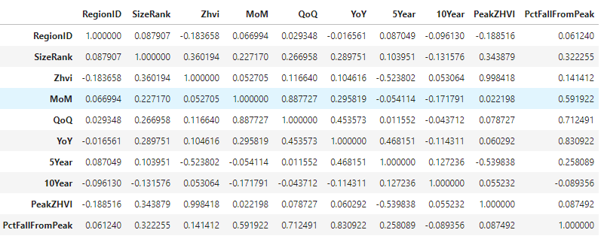
Zillow Data Exploration
Takeaways
Zillow Value and 5 Year Growth showed moderate correlation
10 Year Growth would not fully account for Amazon and tech growth
10 Year Growth would skew the data due to the 2009 recession
10 Year Growth appeared inaccurate in Zillow data
Correlation Table of Zillow Data

Slide 14
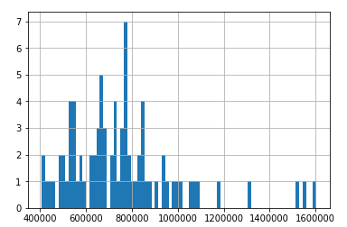
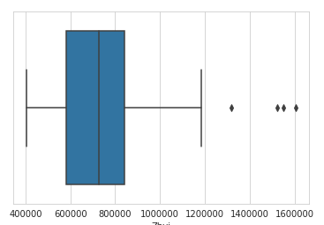
Majority of Neighborhoods averaged between $600-$800K with a few outliers

Slide 15
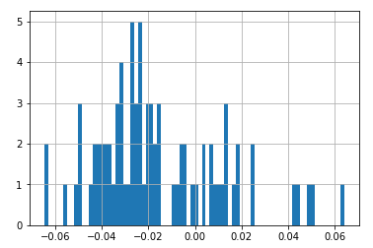
Growth has finally slowed in the past year, adding risk to any investment
Zillow Value % Change YoY

Slide 16
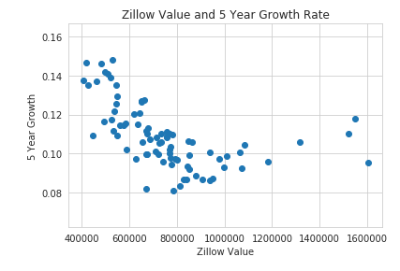
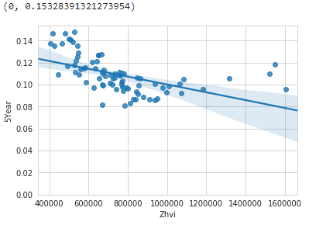
Linear Regression model
R^2 = 0.27

Slide 17
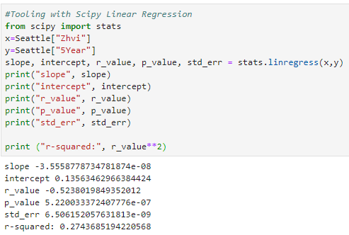
Examining regression Model results
We cannot draw conclusions from only 80 neighborhood data points
Scatterplot may suggest high competition for starter homes in cheaper neighborhoods
Data may suggest expensive neighborhoods are also in high demand from tech executives

Slide 18
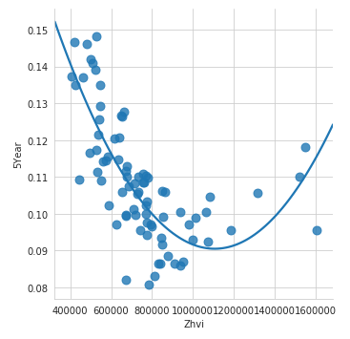
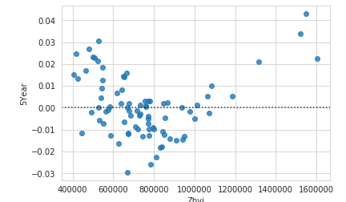
Residual Plot
Polynomial Regression
Residual plot may indicate Polynomial Regression is a better fit
Let’s examine the expensive outliers

Slide 19
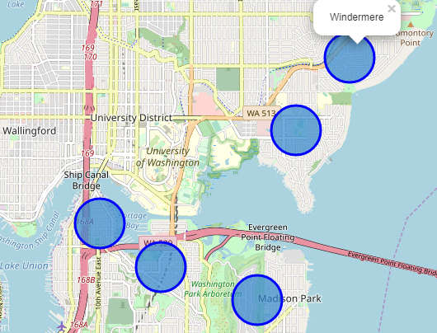
5 most expensive neighborhoods by Avg ZHVI
Laurelhurst = $1,604,300
Madison Park = $1,555,500
Windermere = $1,552,200
Portage Bay = $1,317,400
Montlake = $1,184,300
Clustered around the University of Washington
Border water
Northeast of Downtown

Slide 20
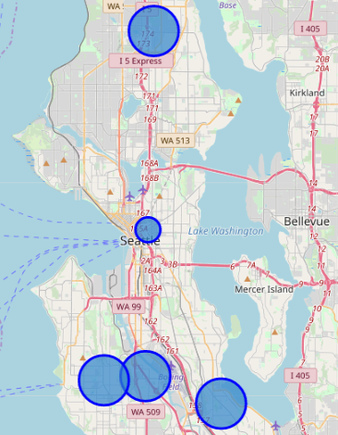
5 Cheapest neighborhoods (if you call $400k Cheap)
Northgate = $405,300
South Park = $418,600
Rainier View = $424,500
First Hill = $445,400
South Delridge = $463,200
All are far from Downtown accept for First Hill
All lack the “urban vibe” accept for First Hill
First Hill is densely populated and lacks single family homes, contributing to low average ZHVI
First Hill is comprised of older construction

Slide 21
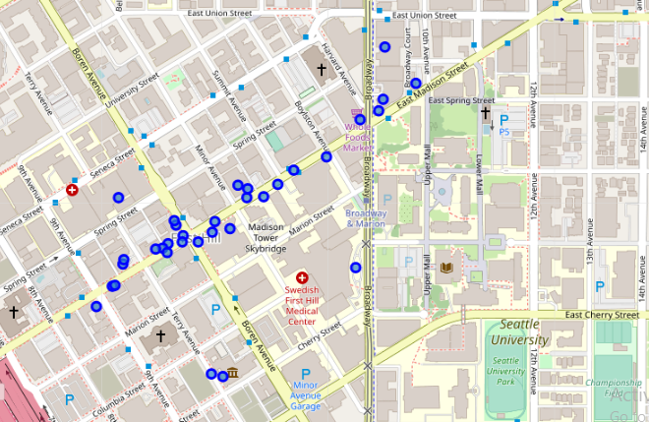
Hidden Value in First Hill
Indicators of Valuable Real Estate
Cluster of Foursquare Venues on First Hill
5-10 Minute walk from Downtown
Borders Capitol Hill, Seattle’s “trendiest“ neighborhood
Nicknamed “Pill Hill” due to the high concentration of hospitals
Borders Seattle University and Seattle Central Community College
Has a “Whole Foods”
Intersection of major bus route, street car, and 5 mins from light rail

Slide 22
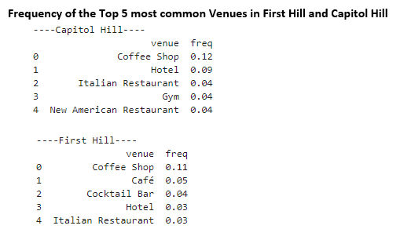
Foursquare Data Exploration
Limitations in Free version of Foursquare API
Limited to 950 API calls per day
Only pulls 100 Venues per neighborhood
Certain “non-food” Venues seem to be excluded
Shopper and Consumer Trends unavailable
Final data merge turned out 80 neighbouhoods into 66

Slide 23
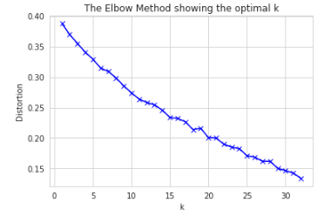
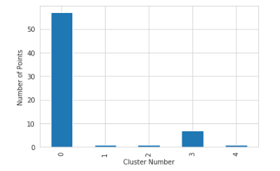
Clustering the Seattle Neighborhoods
The first algorithm used was K Means Clustering
The Elbow Method was used to determine the optimal number of “K” Clusters
After much trial and error, the Elbow Method was not effective on this dataset
Optimal "joints" often resulted in clusters of 0 or 1 neighborhoods
5 Clusters seemed optimal

Slide 24
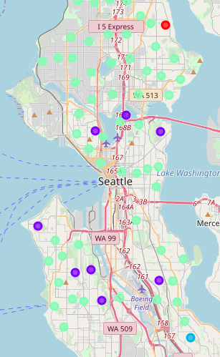
Seattle is known for Coffee?
High concentration of coffee shops often grouped most neighborhoods together (green dots)
A high concentration of Gardens, Parks and Playgrounds (purple dots)
Further study will warrant “feature extraction”

Slide 25
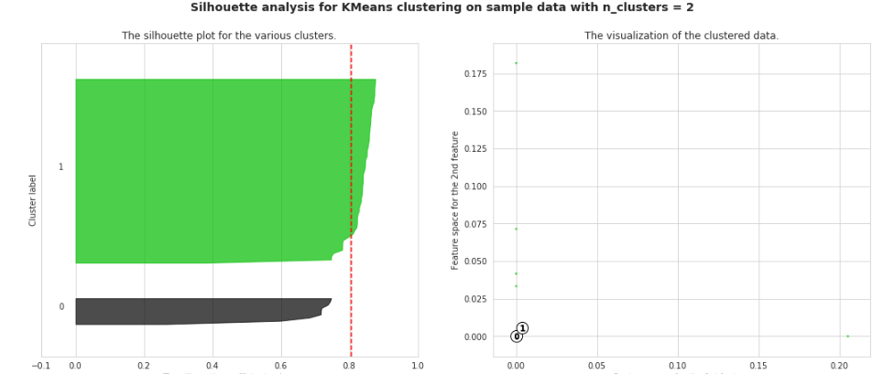
Silhouette Analysis confirmed the macro data was most accurate with 2 or 3 clusters

Slide 26
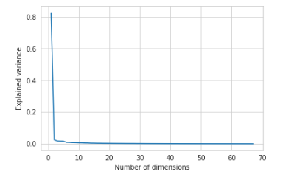
Principal Component Analysis confirms 2 or 3 features explains most of variance

Slide 27
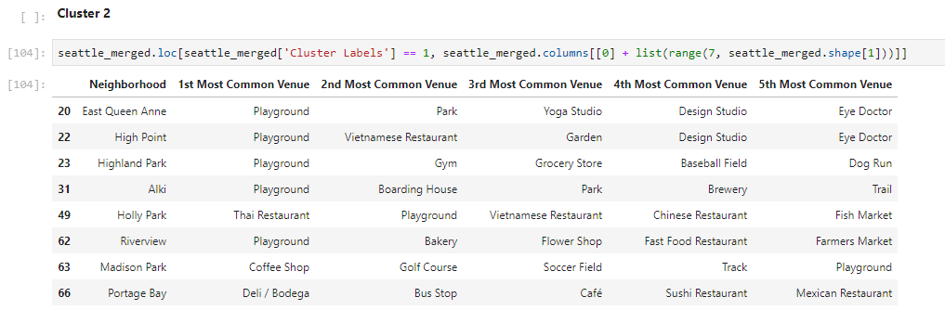
Green space Cluster

Slide 28
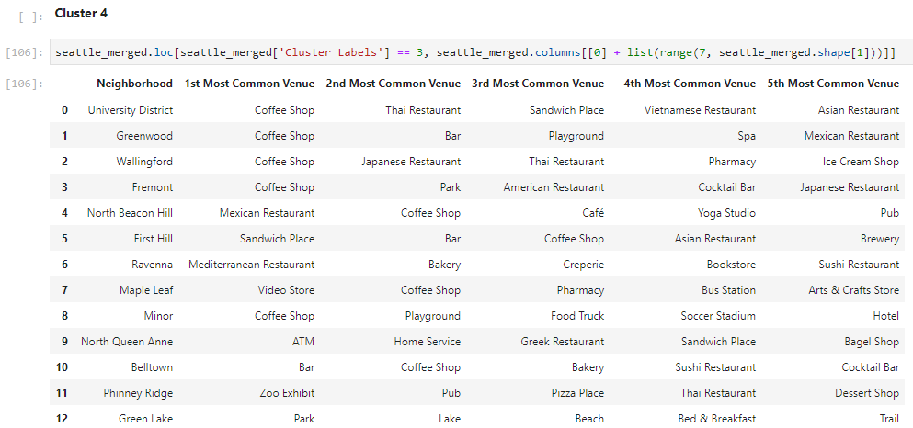
Coffee Cluster

Slide 29
Discovering the Curse of Dimensionality
Finally, we wanted to examine the relationship between Seattle Venues and Zillow Value
Multivariate Regression was used to determine the relationship between ZHVI and all 220 unique Venue Categories
Data becomes sparse when we add dimensions and distances lose meaning
Sample density regions require exponential observations to stay consistent
Even just 5 dimensions would require 3.2 million observations
Example of Density in 3D Space
N = Number of Observations
D = # of Dimension in data
N=20
D=3
N^1/D
20^1/1 = x^1/3
x = 20^3
x = 8000 observations is required to have the same density in a 3D space as 20 observations in 1D!

Slide 30
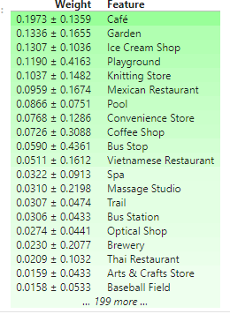
Explaining Weights and Predictions for feature extraction
The ELI5 library was used to examine the PermutationImportance of the Multivariate Regression Model
Cafes ,Gardens, and Ice Cream Shops had the heaviest weights
While no predictions can be made, this information can help with future feature extraction

Slide 31
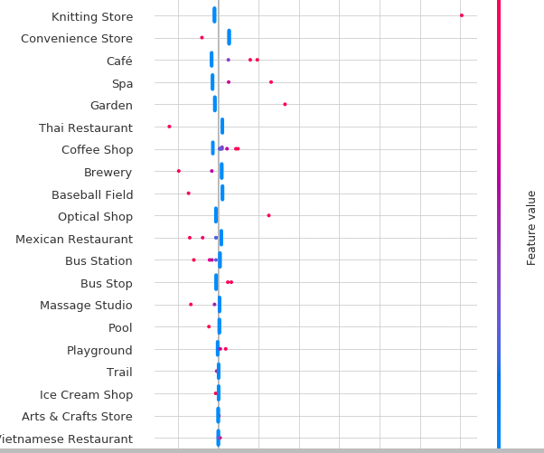
Shaply value
The SHAP package was imported to further examine weights and importance of features of the linear model
Shaply Values are named for the late Nobel Prize winning Economist Lloyd Shaply
SHAP uses Game Theory to explain the predictions of a model
Helped to identify the 1 Knitting Store in Seaview accounting for 25% of Venue Occurrence

Slide 32
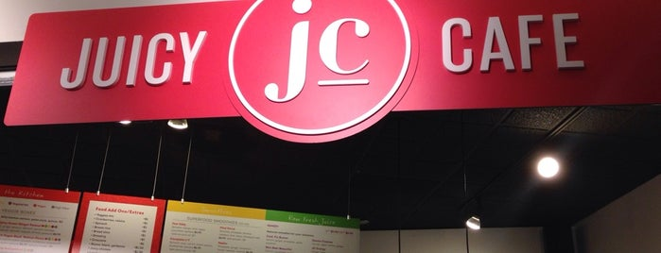

Moving Forward with this study
Juice Bar? Coffee Shop? Restaurant? Liquor Establishment?
Feature Selection will be examined further
Feature Extraction = Gardens+Parks+Playgrounds = Green Space
Predict [Zillow Value] from [Green Space Feature]
Desired Outcomes
+1 Green Space = 12% Increase in ZHVI
Café = Restaurant or Coffee Shop?
Coffee Shop + CafeCoffee Shop = Coffee Venues
Restaurant + CafeRestaurant = Restaurant Venues
Incorrect Categorization by FourSquare
Actual = Juice Bar+Restaurant

Slide 33
Final Recommendation
Purchase FourSquare Premium and other alternative data sources
Max Venues
Foot Traffic
Park Lot Traffic
Cell Phone Geo Location Data
Consumer Trend Data

